Slide 1
Massachusetts Water Resources Authority
Community Support Program Update
to the
MWRA Advisory Board
June 25, 2026

Slide 2
Overview of Programs
I/I Local Financial Assistance Program
Local Water System Assistance Program
Lead Service Line Replacement Program
Leak Detection Technical Assistance Contract
Water Conservation Program

Slide 3
Funding Process
Define Your Project
  Determine Priorities, Project Area and Scope of Work
    Target Areas for Biggest Impact
    Coordinate Work with Other Roadway Projects
  Put Together Bid Documents
  For Projects over $2 Million, please give MWRA Advanced Notice
Get City/Town Approval
  Need Vote of City Council/Town Meeting to Receive Funding
  Projects can be Funded Retroactively
Submit Application
  Funds are Distributed Quarterly – mid February, May, August and November
  Applications Due One Month Prior to Funding Date
Funds Distributed into Community MMDT Account
  MWRA Staff Tracks Funds and Interest throughout Project Until Closeout

Slide 4
Massachusetts Water Resources Authority
Infiltration/Inflow Local Financial Assistance Program
Israel Alvarez and Gloria Kazeera
MWRA Community Support Program

Slide 5
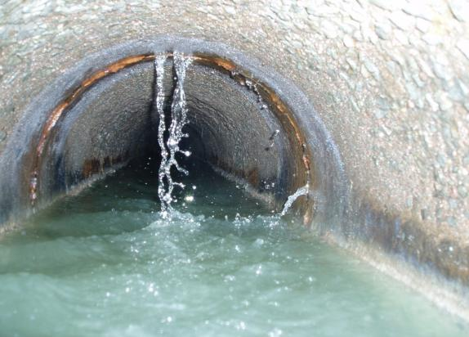
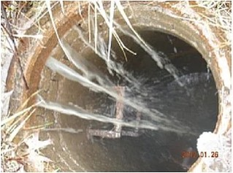
MWRA I/I Local Financial Assistance Program
Program initiated in May 1993
Goal: Rehabilitation of local sewer systems and long-term reduction of I/I
Infiltration/Inflow (I/I)
Infiltration
(Groundwater via physical defects)
Inflow
(Stormwater via direct connections)

Slide 6
MWRA I/I Local Financial Assistance Program Funding Summary
$1.086 Billion approved (16 Phases)
Community allocations based on percent share sewer charge
All 43 communities participating
$633M distributed (through June 2026)
723 local projects funded
619 projects complete / 104 projects ongoing
$47M distributed to 18 communities in FY26

Slide 7
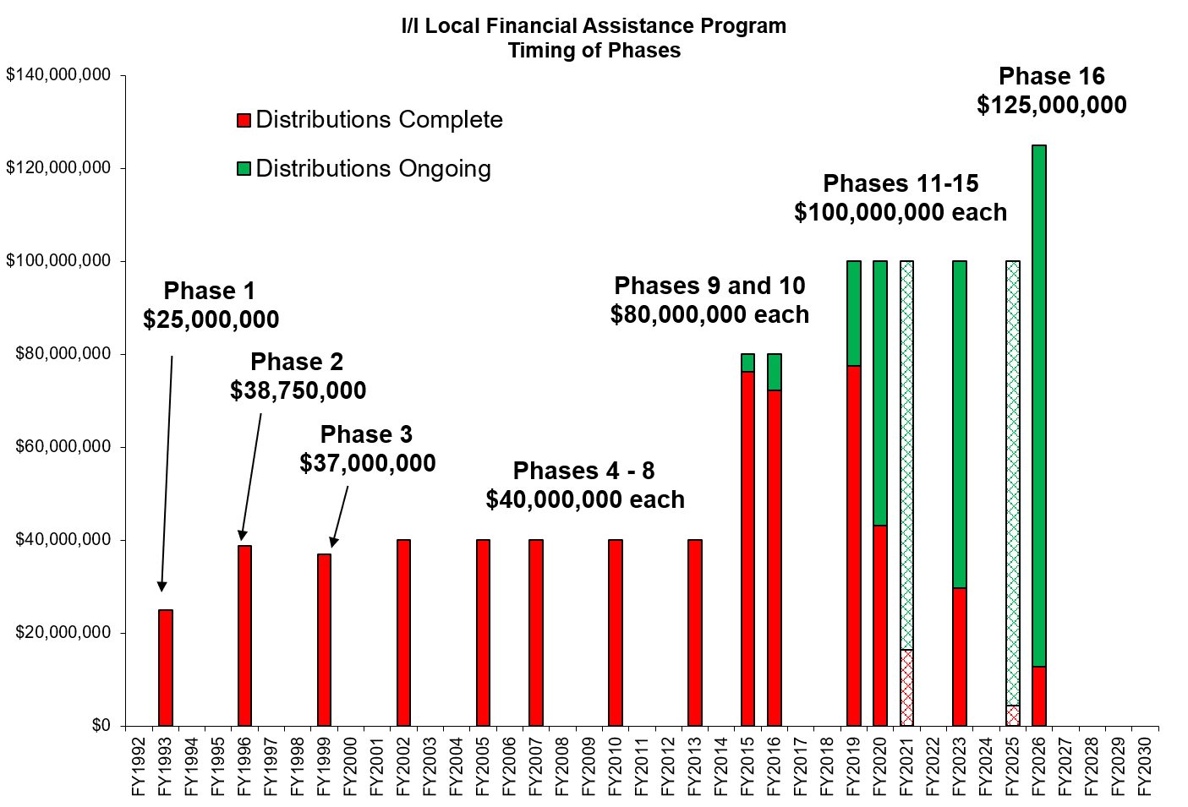
MWRA’s Long-Term Commitment to Fund I/I Reduction

Slide 8
I/I Funding - Distributions and Repayments
FY35 Target = $1.086 Billion
$633M distributed (FY93 – FY26)
$221M loans repaid to MWRA
Notes:
All scheduled community loan repayments have been made, a total of $187 million to date.

Slide 9
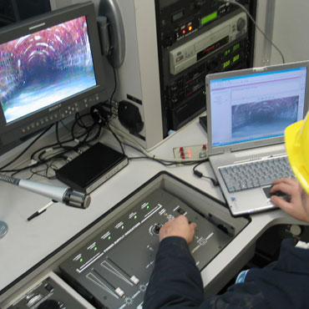
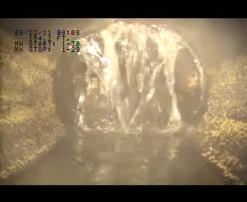
Planning and Sewer Inspection Projects
2,614 miles of sewer TV inspected
1,758 miles of sewer flow isolated
1,489 miles of sewer smoke tested
70,535 sewer manholes inspected
79,232 buildings inspected

Slide 10
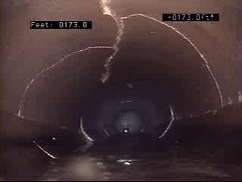
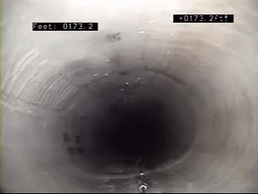
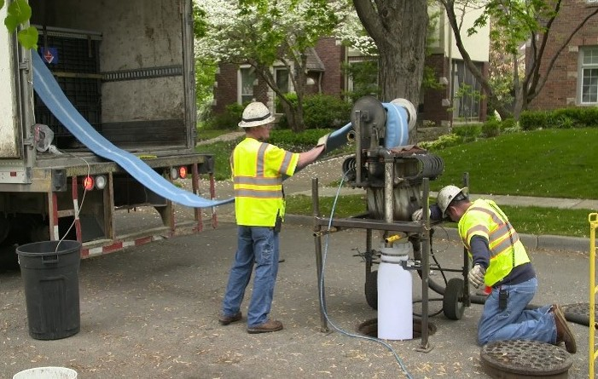
Projects Targeting Infiltration
84 miles of sewer replaced
365 miles of cured-in-place-pipe (CIPP) liner installed
195 miles of sewer tested/chemically sealed
3,415 sewer spot repairs
20,129 service connection repairs
4.8 miles of underdrains sealed

Slide 11
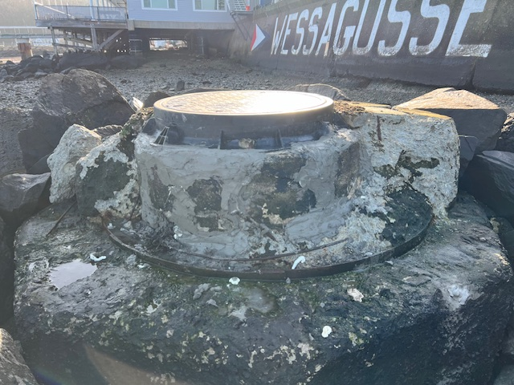
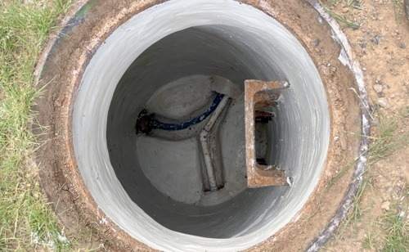
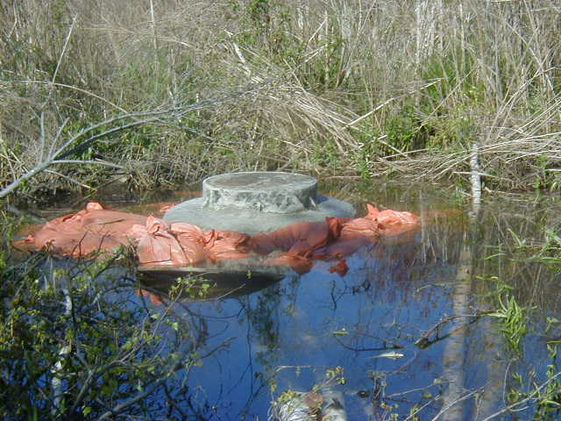
Projects Targeting Inflow
1,208 catch basins disconnected
49 miles of new or replaced storm drains installed
24,994 manholes rehabilitated/sealed
4,126 manhole covers replaced or inflow seals installed
551 sump pumps redirected
5,839 downspouts/area drains disconnected

Slide 12
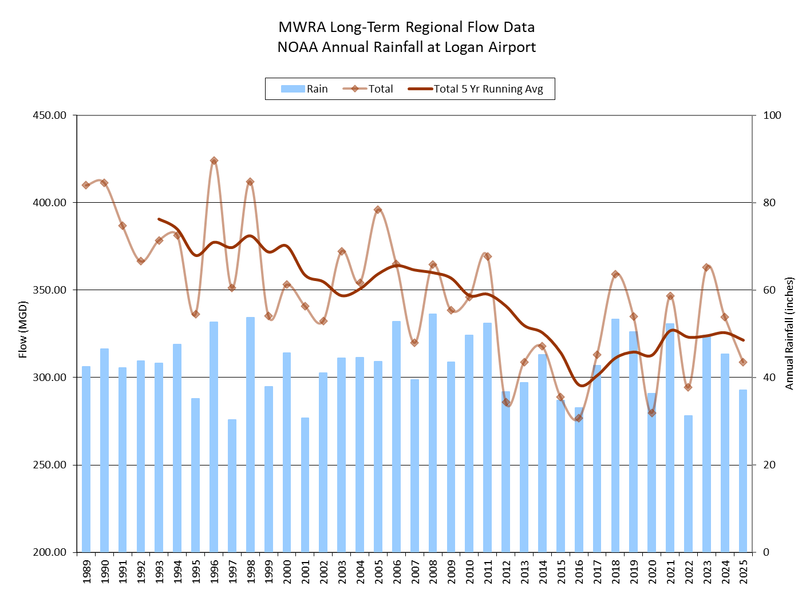
MWRA Long-Term Regional Flow Data – Gradual Decrease in Flow

Slide 13
Massachusetts Water Resources Authority
Local Water System Assistance Program
Claudia Baptista and Gloria Kazeera
MWRA Community Support Program

Slide 14
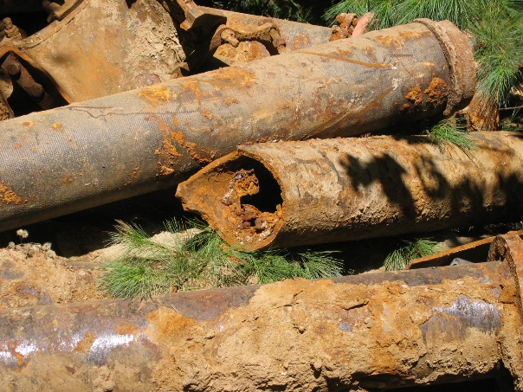
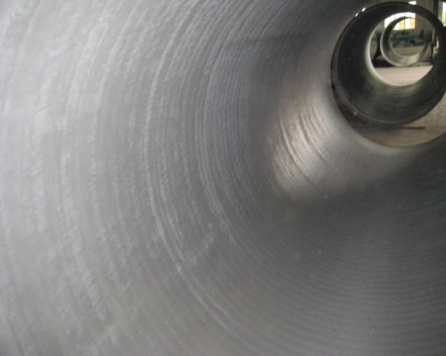
MWRA Local Water System Assistance Program (LWSAP)
MWRA’s goal: To provide financial assistance to member communities to improve local water systems to maintain high water quality as it passes from MWRA facilities through local pipelines to customers’ taps
0% interest loans
Repaid over 10 years

Slide 15
MWRA Local Water System Assistance - Ongoing Phases

Slide 16
MWRA Local Water System Assistance Program - Funding Availability
Community allocation based on % share water charge and % share unlined pipe
Phase 3 funds fully allocated as of July 1, 2026
  FY27 is Year 10
  Approved for distributions through FY30
Phase 4 funds allocated as of July 1, 2026
  FY27 is Year 3
  Approved for distributions through FY35

Slide 17
MWRA Local Water System Assistance Program – Funding Summary
Total Approved
$30 Million Pilot Program
$1.026 Billion interest-free loans in four (4) Phases
Total Distributed
$670 million in LWSAP
695 local projects funded
$36.4M distributed to 20 communities in FY26
45 out of 48 communities have participated

Slide 18
MWRA Local Water System Assistance Program – Long Term Distribution Graph

Slide 19
MWRA Local Water System Assistance Program – Eligible Projects
Projects that improve water quality and enhance system efficiency
Eligible projects include:
Water Main Replacement/ Rehabilitation: Complete replacement or abandonment, sliplining , cleaning and lining of unlined and asbestos-cement water mains.
Lead Service Line Identification and Replacement: Initiatives to locate and remove lead pipes, lead-lined pipes, brass pipes, and galvanized lines connected via lead goosenecks, ensuring safe drinking water.
System Upgrades and Improvements: Installation, looping, or rehabilitation of dead-end water mains to improve water circulation, as well as the replacement of valves and hydrants.
Water Storage and Facilities: Installation, rehabilitation, and replacement of water storage tanks to maintain system pressure and capacity.
Engineering and Planning Support: Essential professional services, including the planning, design, and construction management associated with watermain improvements.

Slide 20
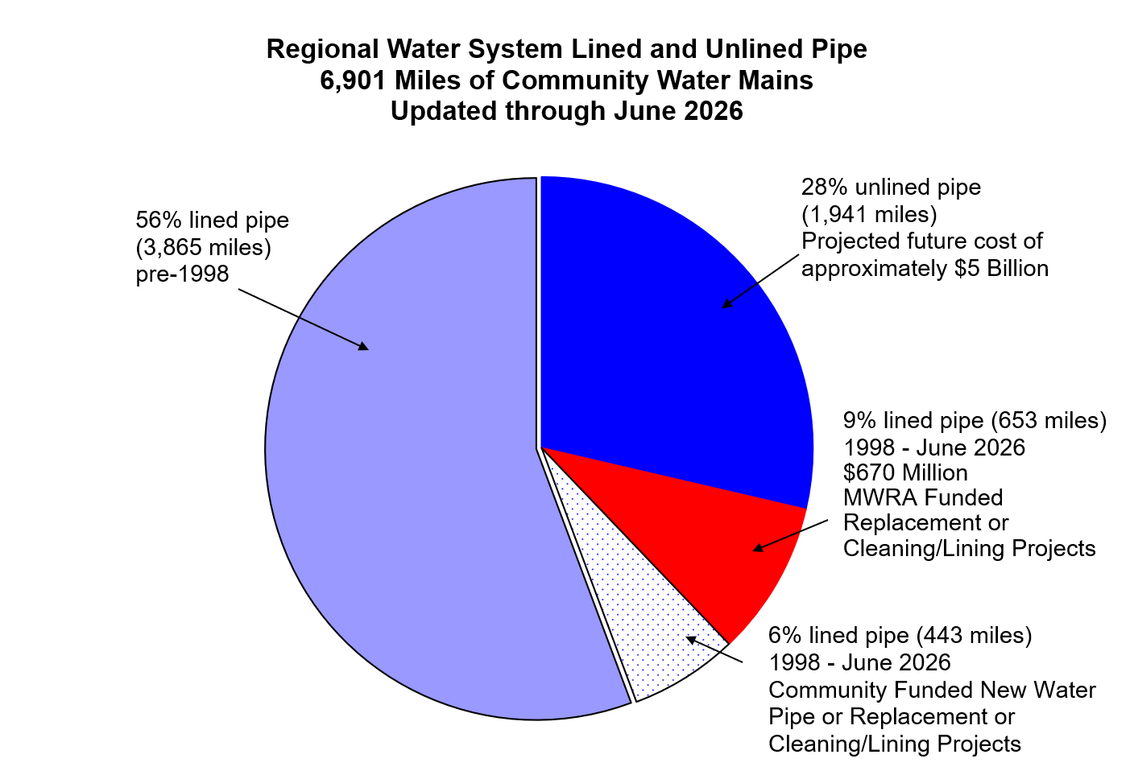
MWRA Local Water System Assistance Program Pie Chart

Slide 21
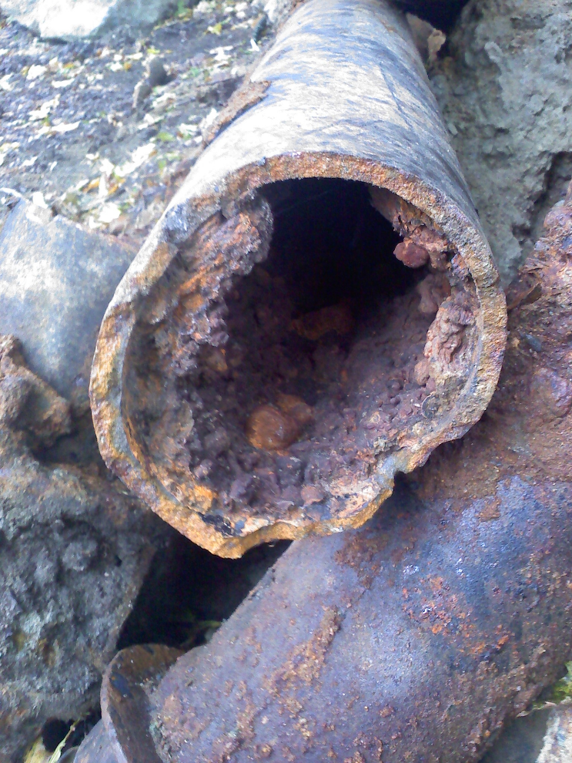
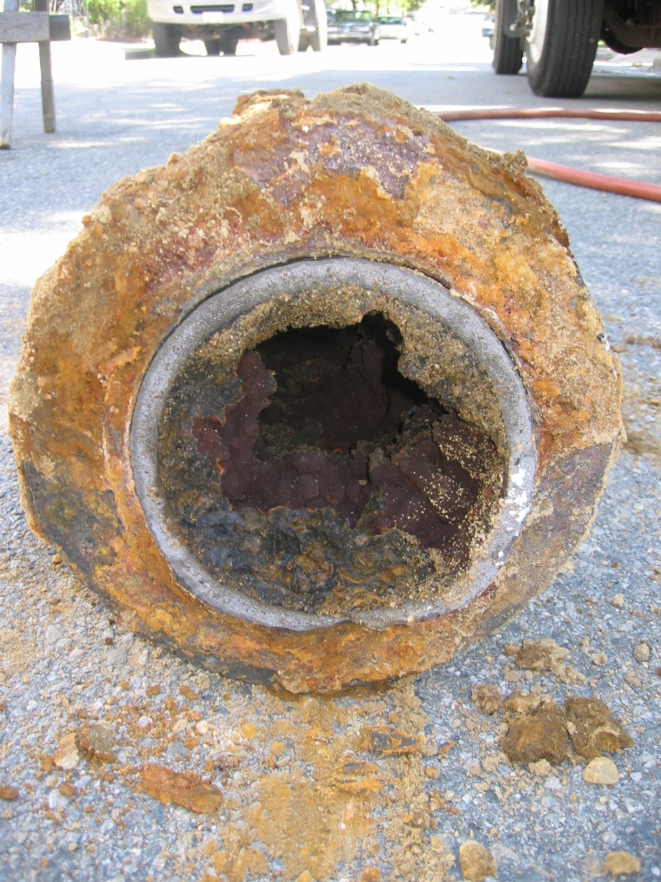
Tuberculated Water Mains

Slide 22
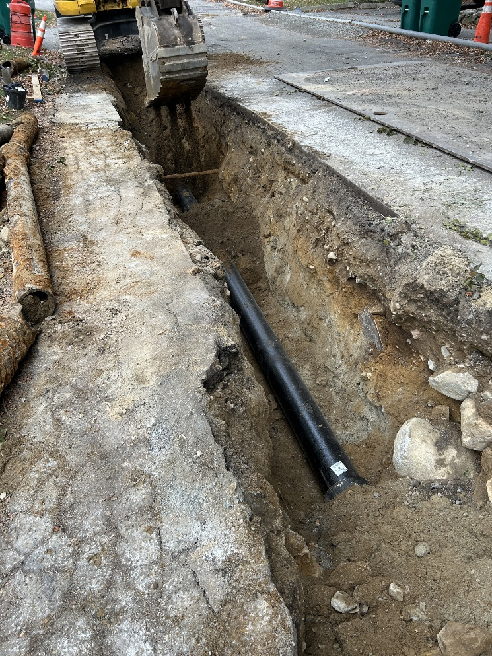
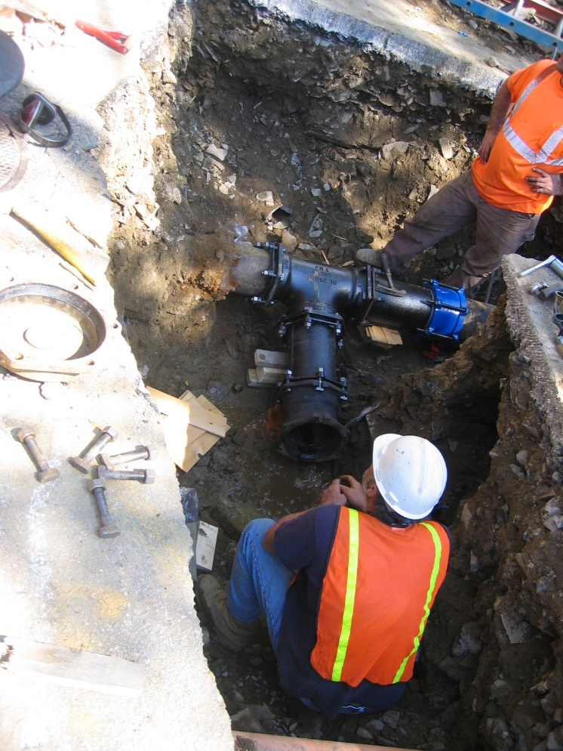
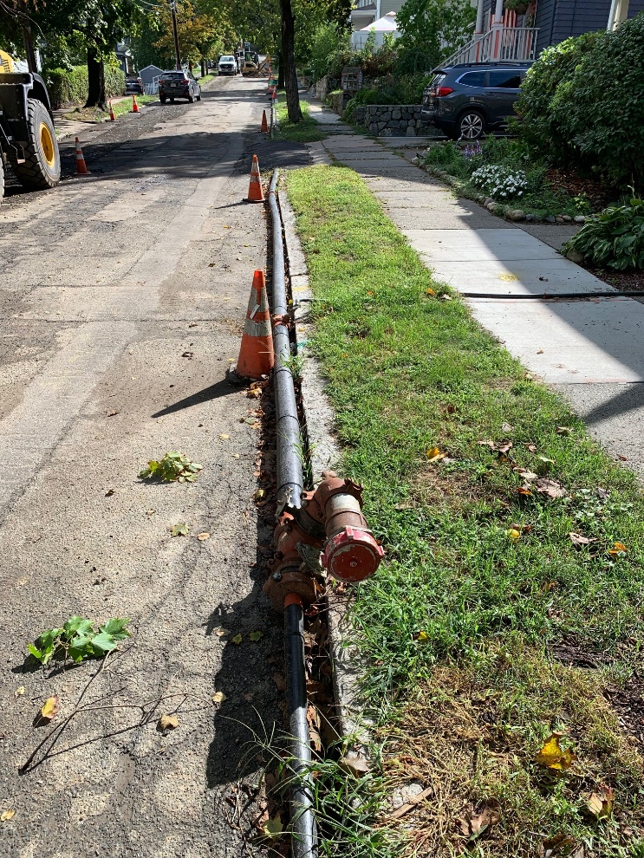
Water Main Replacement

Slide 23
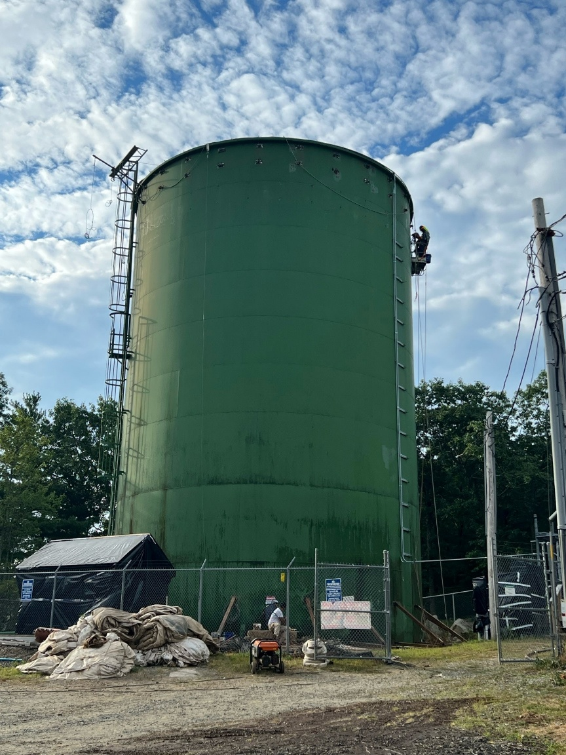
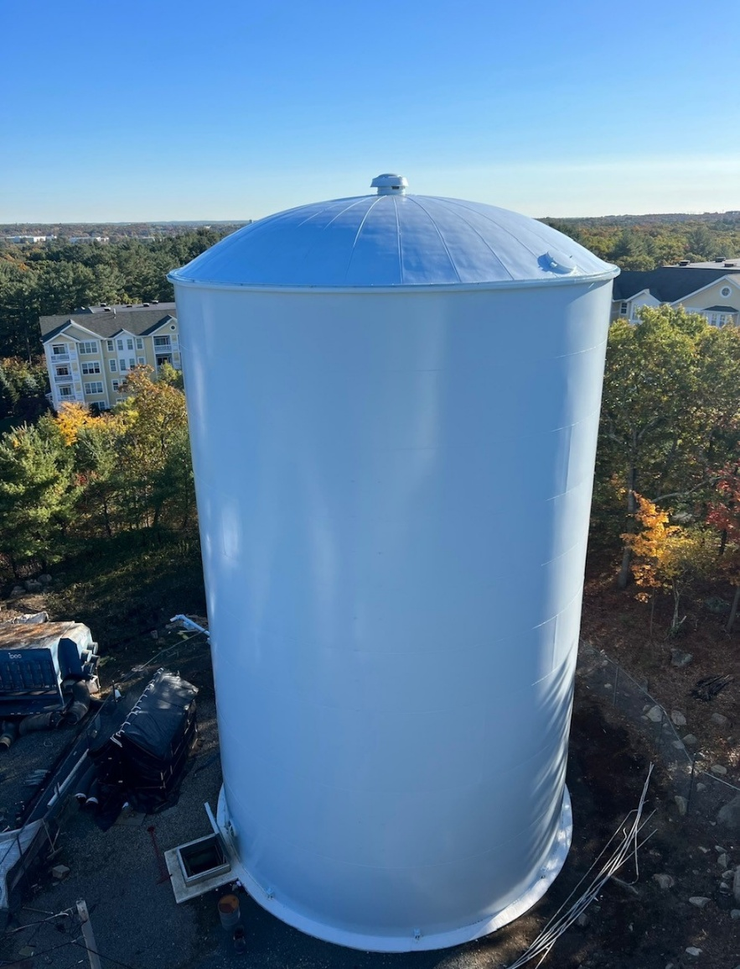
Water Tank Rehabilitation

Slide 24
MWRA Local Water System Assistance Program – Tier 2 Projects
Tier 2: Target Water system efficiency
Eligible projects include:
Water Utility Setup: water meters and reading system purchase and installation
Water booster pump station installation and/or upgrades;
GIS mapping and system modeling; and,
Engineering planning, design and construction services associated with the above items

Slide 25
Water Program Phase Funds Allocated Over 10 Years

Slide 26

Other Community Support Programs
Leak Detection Technical Assistance Contract
  MWRA Communities required to do survey every 2 years
  Current Contract through April 2027
  Liston Utility Services $165/mile
  MWRA pays Contractor and Community repays MWRA one year later
Water Conservation Program
  Free Fixtures (Showerheads, Aerators)
  Free Brochures
  Online Request Form https://wc.mwra.com/home

Slide 27
Massachusetts Water Resources Authority
Lead Service Line Replacement Program
David Granados
MWRA Community Support Program

Slide 28
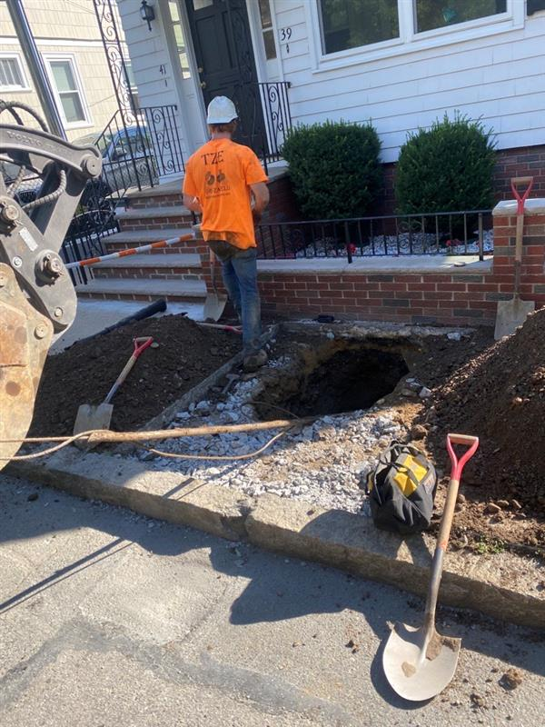
MWRA Lead Replacement Program
Launched in 2016 - $100 Million for community projects. 10 year interest-free loans
Must replace ALL lead pipe within a service line - BOTH public and private portions
Eligible projects include Lead Service Line Replacements, Lead Goosenecks replacements, addressing unknowns
In 2024, $100 Million was added and a 25% grant included
Replacing the private side at no cost to the homeowner is required to receive the 25% grant. Communities that do not fully fund the private side can still apply for 0% interest loan
No set allocation per community

Slide 29
MWRA Lead Replacement Program: Distributions
22 communities received $75.9 Million to fund 67 projects
Since program revisions $32.1 Million were distributed (grants/loan)
MWRA’s water programs have funded more than 9,700 LSL replacements & 1,700 lead gooseneck replacements
$100M
$124M
$76M
$100M

Slide 30
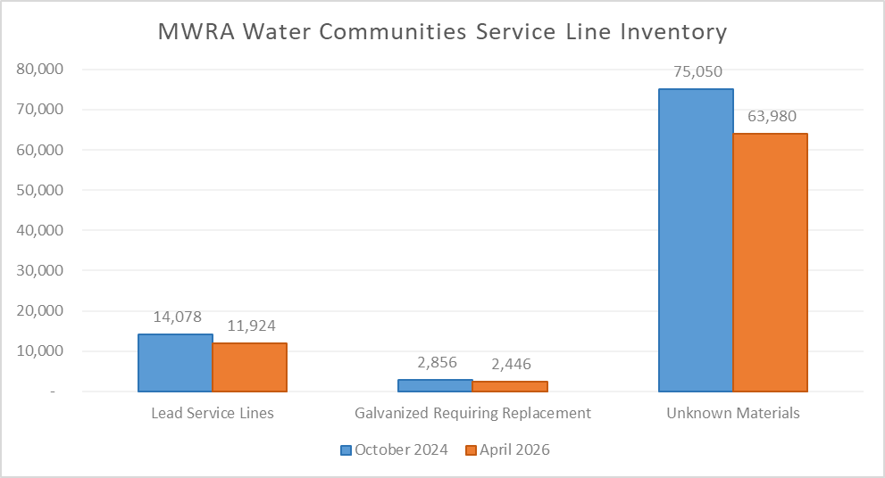
Service Lines Initial Inventory (October 2024) vs April 2026

Slide 31
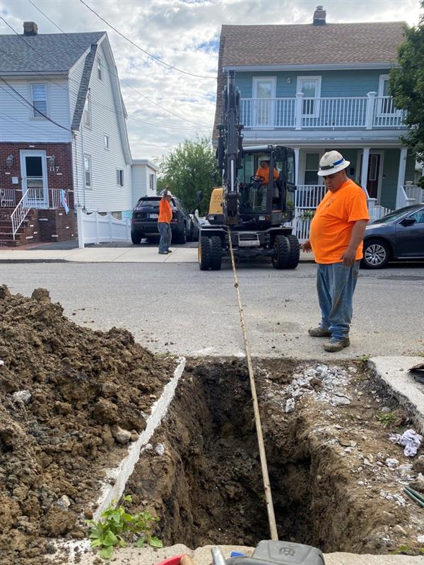
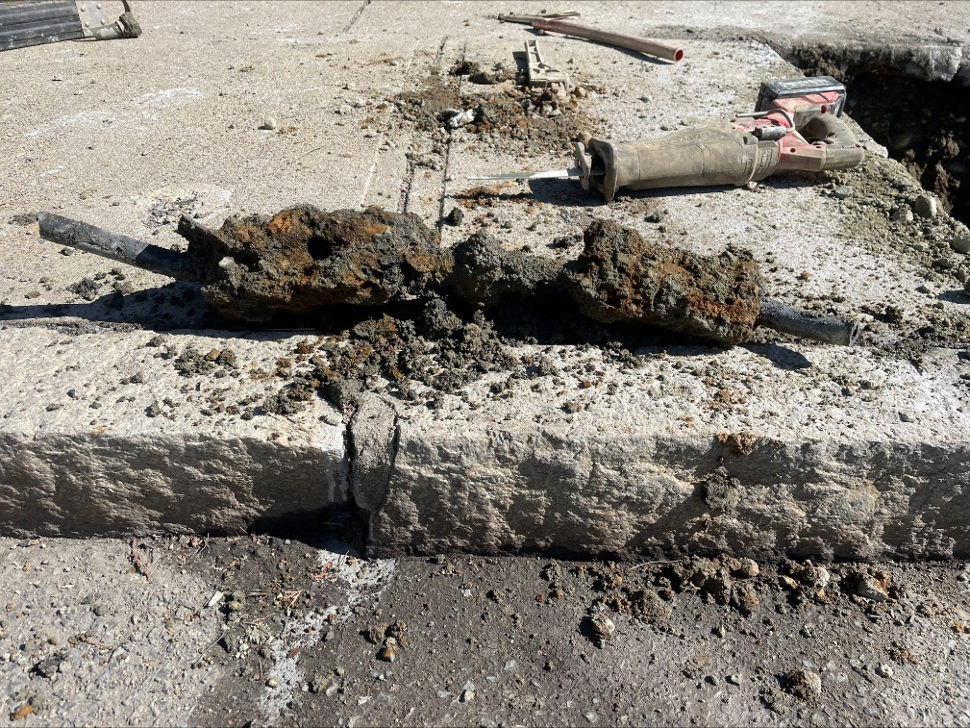
Community Participation
Significant outreach to every community
Technical and Regulatory Support

Slide 32
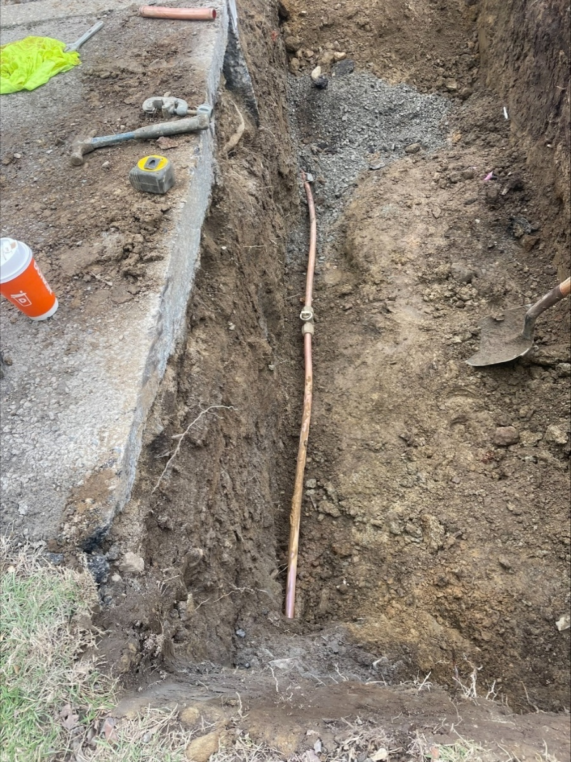
Important Dates and Reminders
July 1, 2026: Consumer Notices Certifications
December 31, 2026: Consumer Notices (LSLs, GRRs, and unknowns)
  New customers (with LSL, GRR, UNK) should receive a notice at the initiation of water service.
November 1, 2027: Baseline Inventories and LSLR Plans
  Yearly Replacement Rates:
  LSLs + GRRs + Unknowns
  Any unknowns determined non-lead will not count toward replacement rate
MWRA Goal: Replace all the LSLs and GRRs, and address unknowns by 2032 to avoid additional treatment. All LSLs have to be removed by 2037 with or without additional treatment.

Slide 33
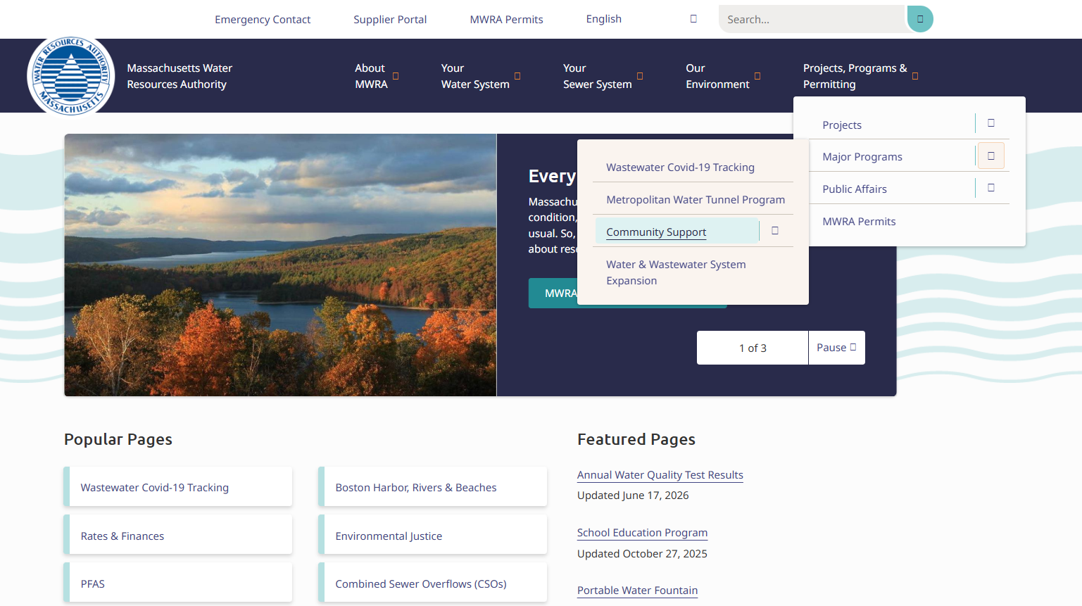
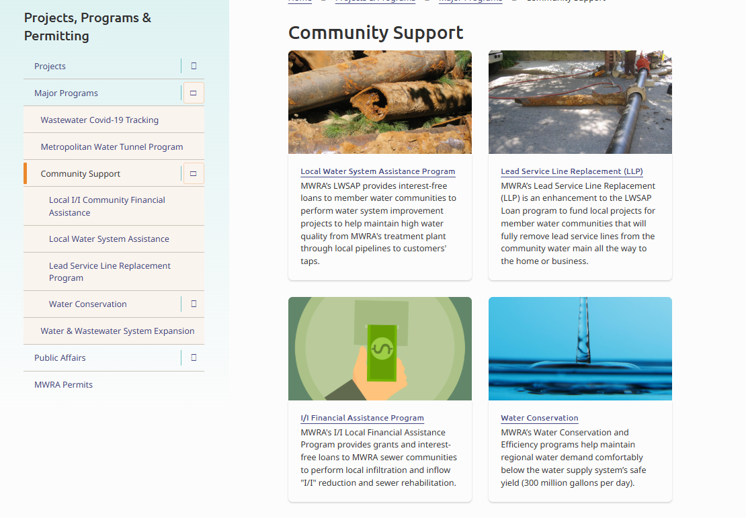
Community Support Program Website

Slide 34
MWRA Community Support Program Staff
I/I Local Financial Assistance Program
    Israel Alvarez Israel.Alvarez@mwra.com
    Gloria Kazeera Gloria.Kazeera@mwra.com
Local Water System Assistance Program
    Claudia Baptista Claudia.Baptista@mwra.com
    Gloria Kazeera Gloria.Kazeera@mwra.com
Lead Service Line Replacement Program
    David Granados David.Granados@mwra.com
Leak Detection or Water Conservation
    Andres Hurtado Andres.Hurtado@mwra.com
Kristen Hall, Sr Program Manager Kristen.Hall@mwra.com

